Slide 1




Interactive Dash Board
- Thakur Prem Singh
This Photo by Unknown Author is licensed under CC BY

Slide 2


Slide 3
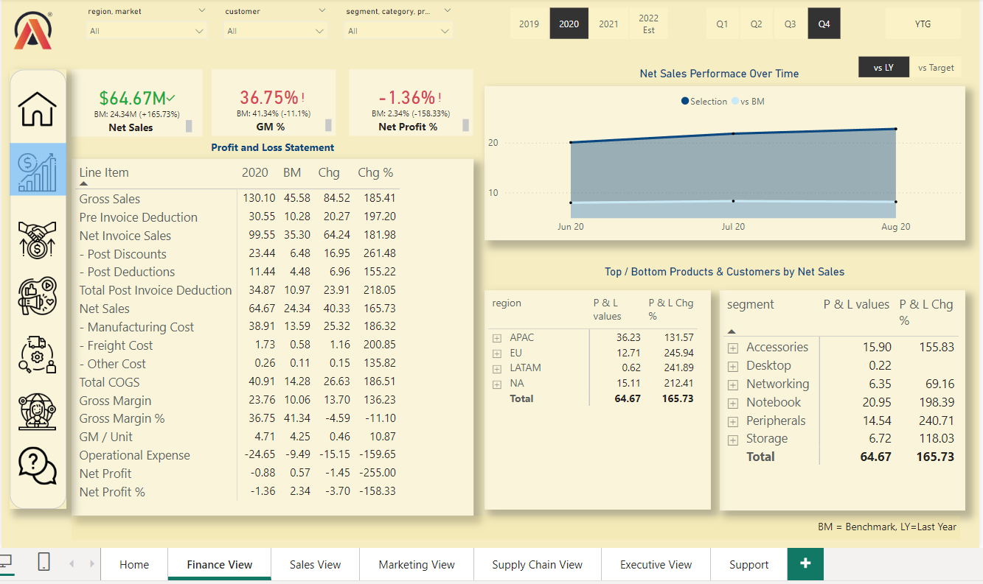

Slide 4
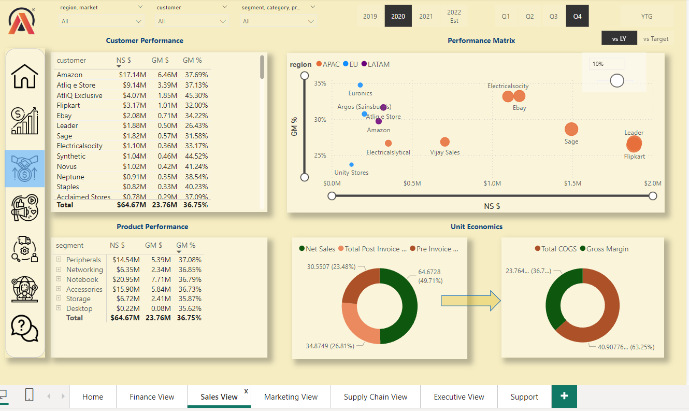

Slide 5
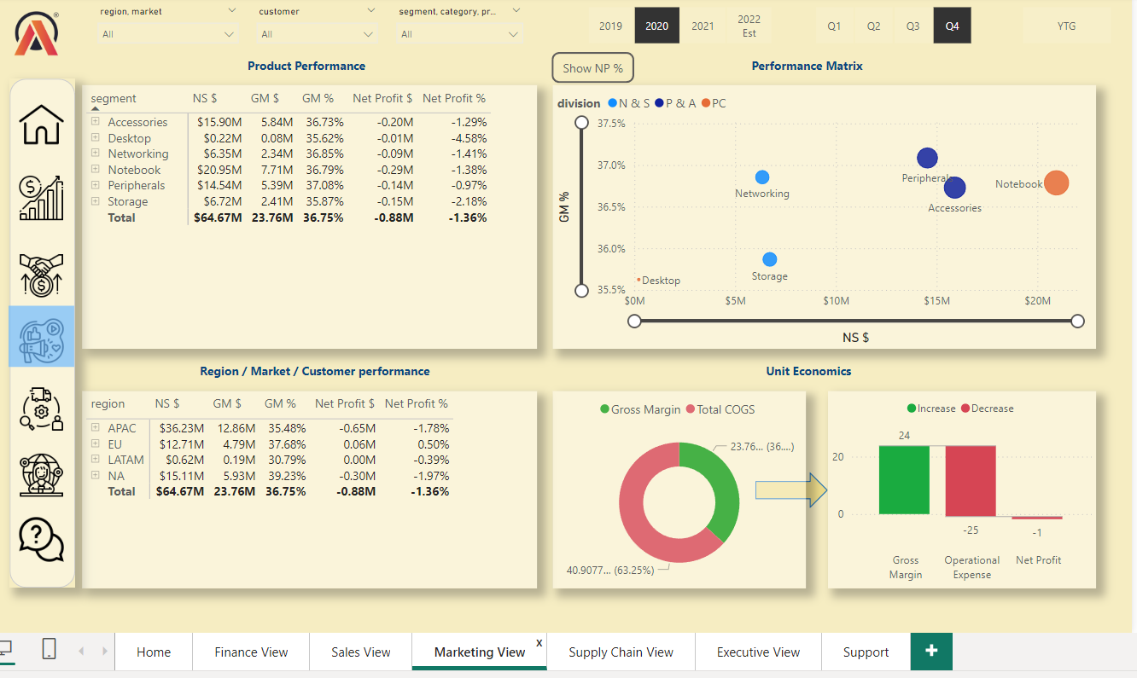

Slide 6
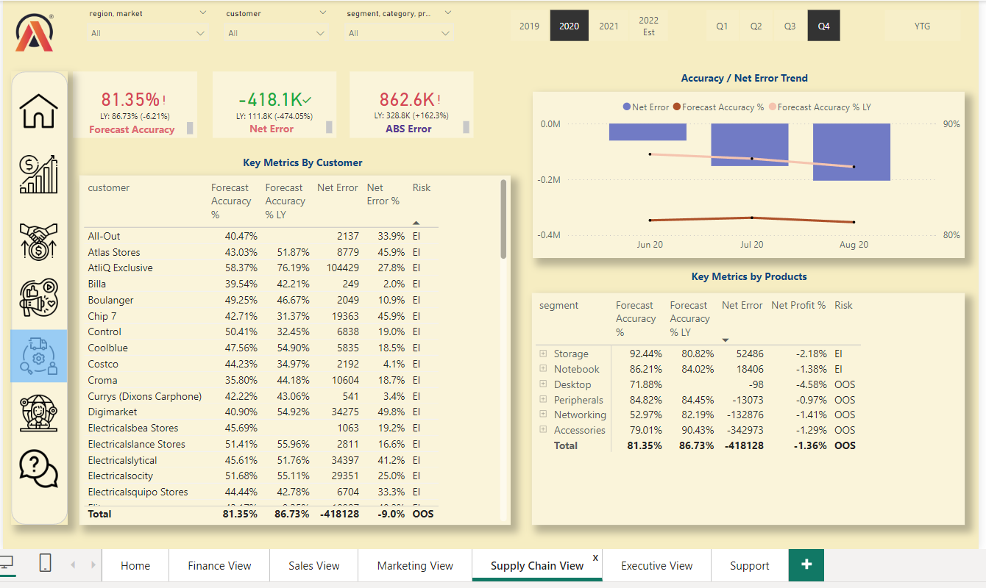

Slide 7
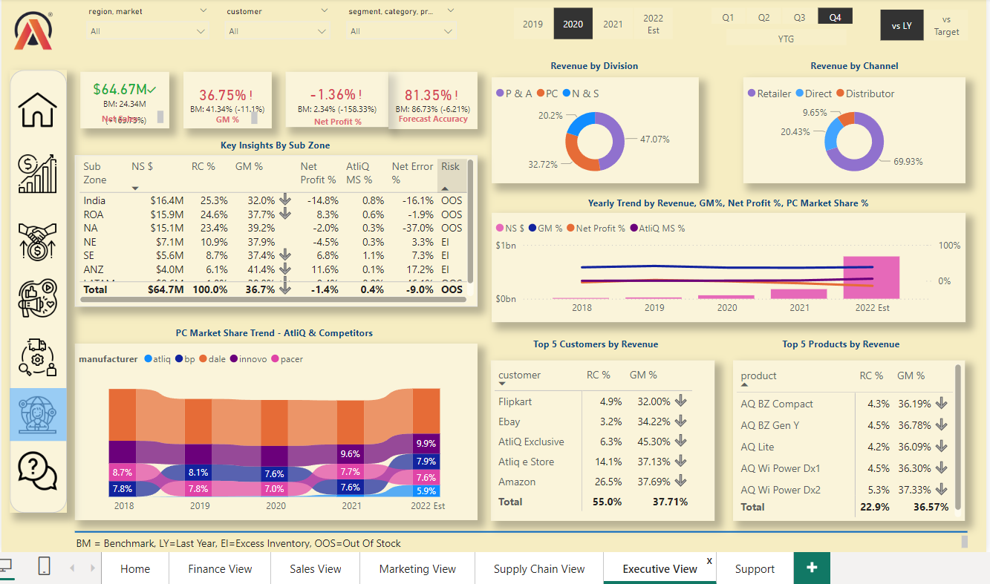

Slide 8
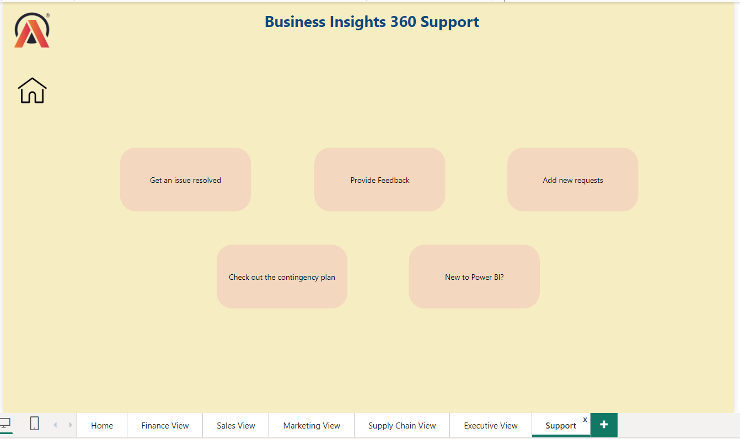

Slide 9
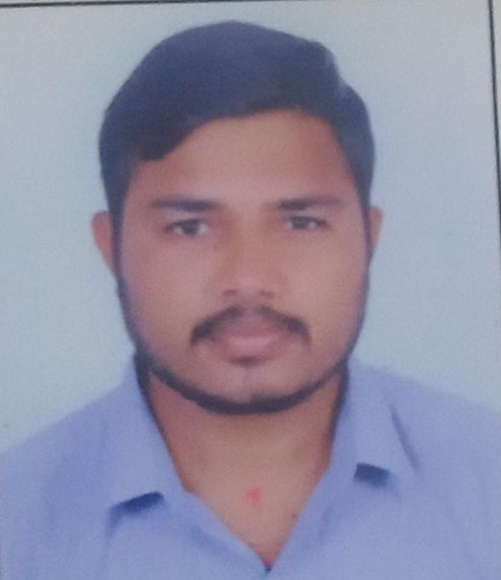

THANK YOU
thakurpremsingh153@gmail.com

